Slide 1

About Gobuster
Key Features
Flowchart
Process
Gobuster

Slide 2
About Gobuster:
ARP Spoofing also called ARP Poisoning is a type of network attack where a hacker sends fake ARP messages on a local network. The goal is to trick devices into thinking the attacker’s MAC address belongs to another device, like the router or gateway. This way, the attacker can control the flow of network traffic and see or change data being sent between two devices.
It’s mostly used in Man-in-the-Middle (MITM) attacks, where the attacker can read, change, or block data between a user and the network.
Standards

Slide 3
Key Features
• Directory Scanning:
Scans websites to uncover hidden directories or files using wordlists.
• DNS Subdomain Bruteforce:
Tries common names to find subdomains that are not normally visible.
• Fast Performance:
Runs super quick because it is built with the Go programming language.
• Custom Wordlists:
You can use any wordlist for custom scans.
• Simple CLI Output:
Gives results in a clean and easy to read format.

Slide 4
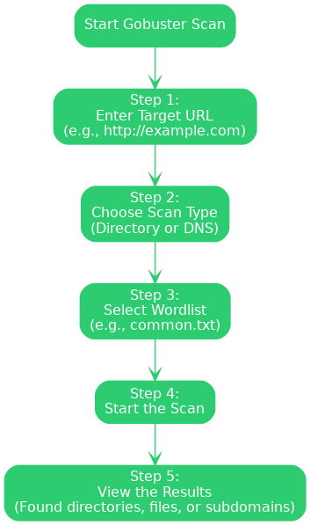
Flowchart

Slide 5
Process
Step 1: Enter the Target URL :
• Enter the address of the website you want to scan.
Example: http://xyz.com
Step 2: Choose Scan Type :
• Decide what kind of scan you want to run:
- Directory Scan (to look for hidden folders or files)
- DNS Scan (to find subdomains of the site)
Step 3: Choose a Wordlist :
• Select a wordlist that Gobuster will use to guess file, folder or subdomain names.
Example: abc.txt
Step 4: Start the Scan • Hit the Start button and Gobuster will begin testing each word from the list against the site.
Click on the model to interact

Slide 6
2. Relation between Earth, Sun, and Moon
Step 5: View the Results
• Once the scan finishes you will see any directories, files or subdomains it found, these might lead to interesting or vulnerable parts of the site.
Let's look at an example Command (Directory Scan):
• gobuster dir -u http://example.com -w /usr/share/wordlists/dirb/common.txt
Now lets breakdown the command:-
• dir: Tells Gobuster to run a directory scan
• -u: Sets the target URL
• -w: Points to the wordlist you want to use
For DNS subdomain scan:
gobuster dns -d example.com -w /usr/share/wordlists/dns/common.txt

